Slide 1
TapVision
Combines "Tap" (interaction method) with "Vision" (for accessibility)
Automated Multilingual Accessibility: Transforming Text from Files, Images, and Web Pages into Speech Using OCR, NLP, and TTS Technologies

Slide 2
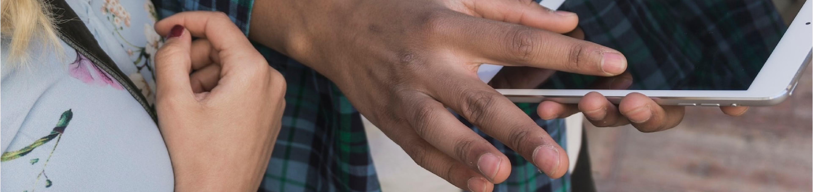
APPLICATION OVERVIEW
This Streamlit application provides a comprehensive solution for text extraction, translation, and speech conversion. It supports various input methods including file uploads and URL inputs, and oﬀers features like OCR for images, translation betweenmultiple languages, and text-to-speech conversion with both online and oﬄinecapabilities.

Slide 3
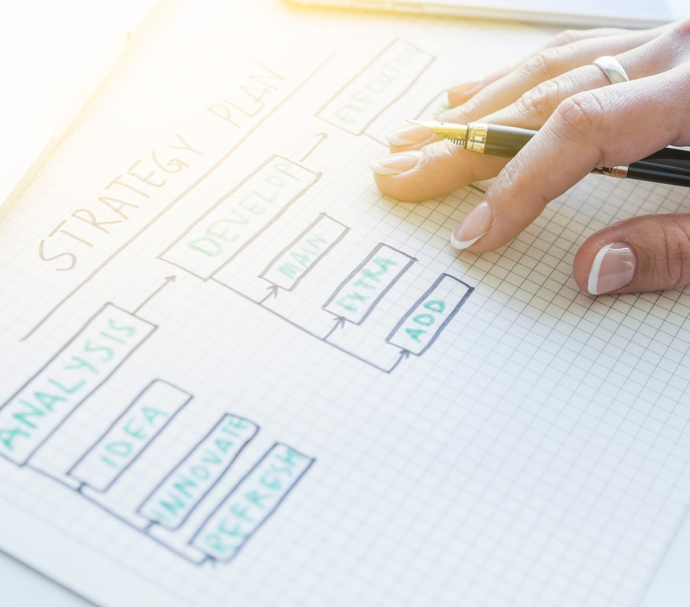

UNDERSTANDING OCR TECHNOLOGY
allows machines to read and convert diﬀerent types of documents, such as scanned paper documents and images, into editable and searchable data. This technology is essential for digitizing text from and .

Slide 4


ROLE OF NLP IN ACCESSIBILITY
enables computers to understand, interpret, and respond to human language. By analyzing text, NLP can
assist in
and
, making it
easier to convert text into speech in various languages.

Slide 5
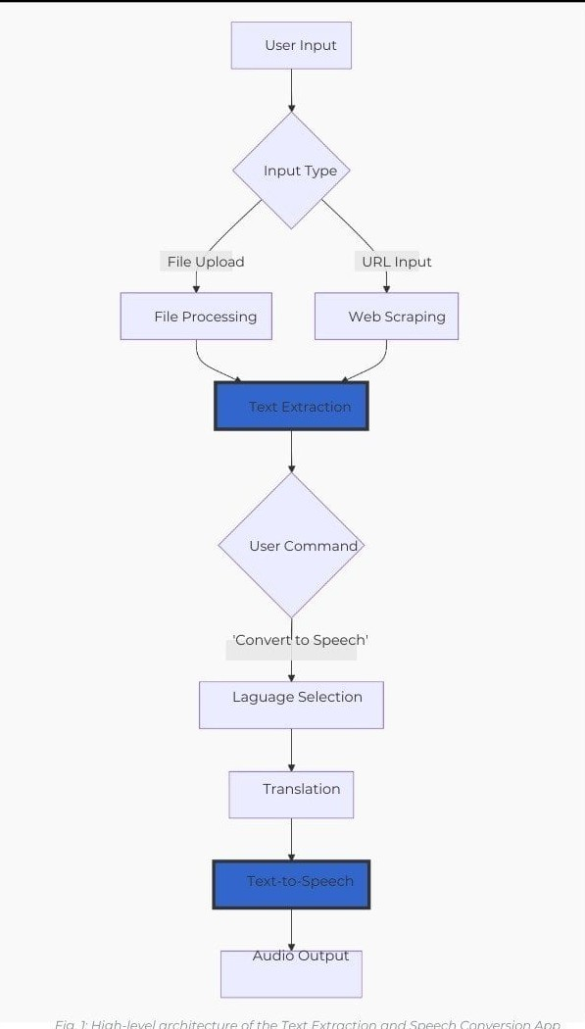
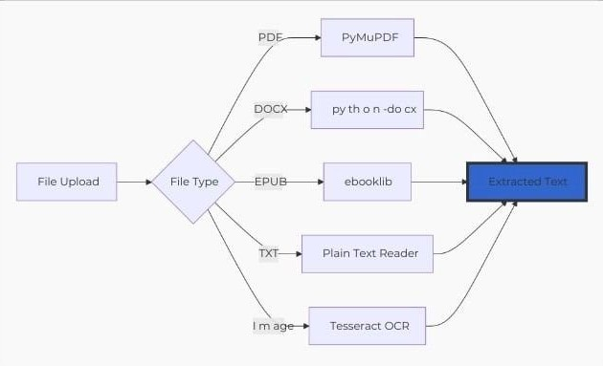
FLOW DIAGRAMS

Slide 6
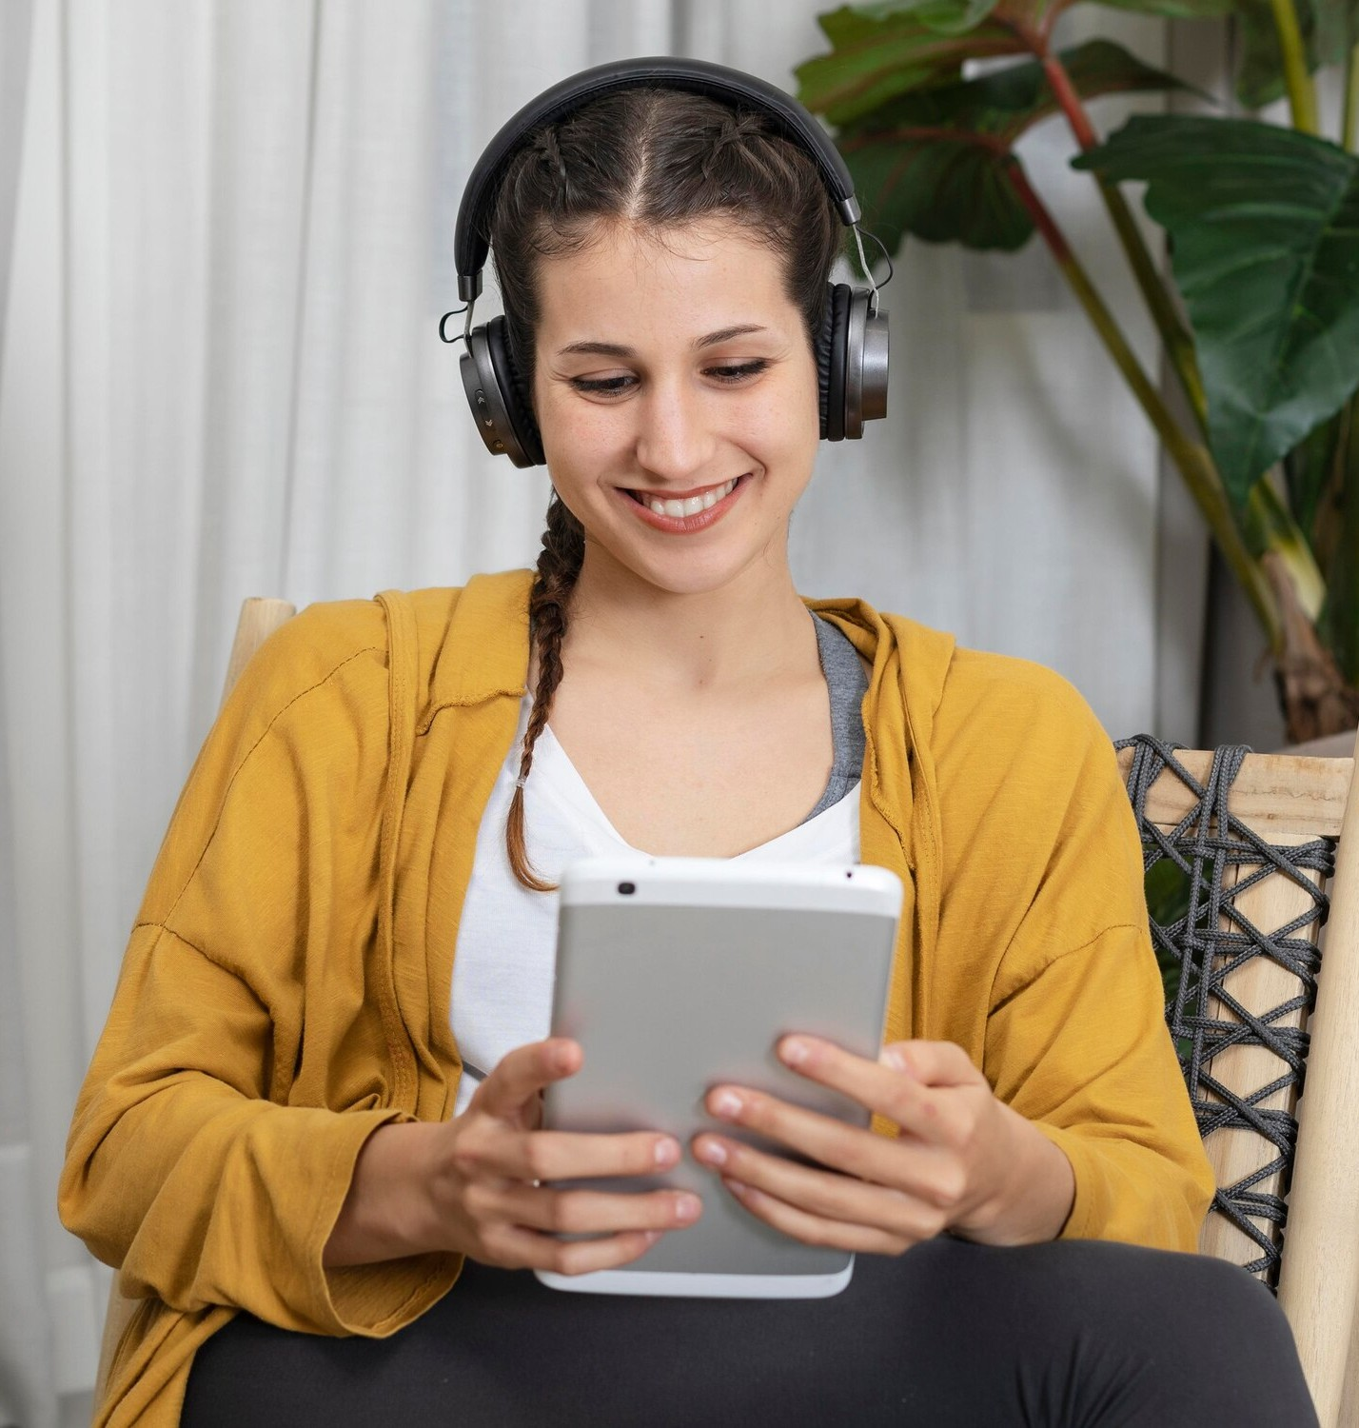
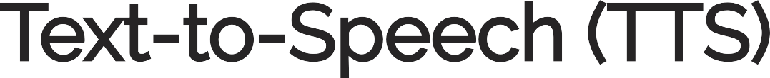
TEXT-TO-SPEECH (TTS) OVERVIEW
technology converts written text into spoken words. It plays a vital role in enhancing accessibility for individuals with visual impairments, allowing them to engage with digital content through output in multiple languages.

Slide 7
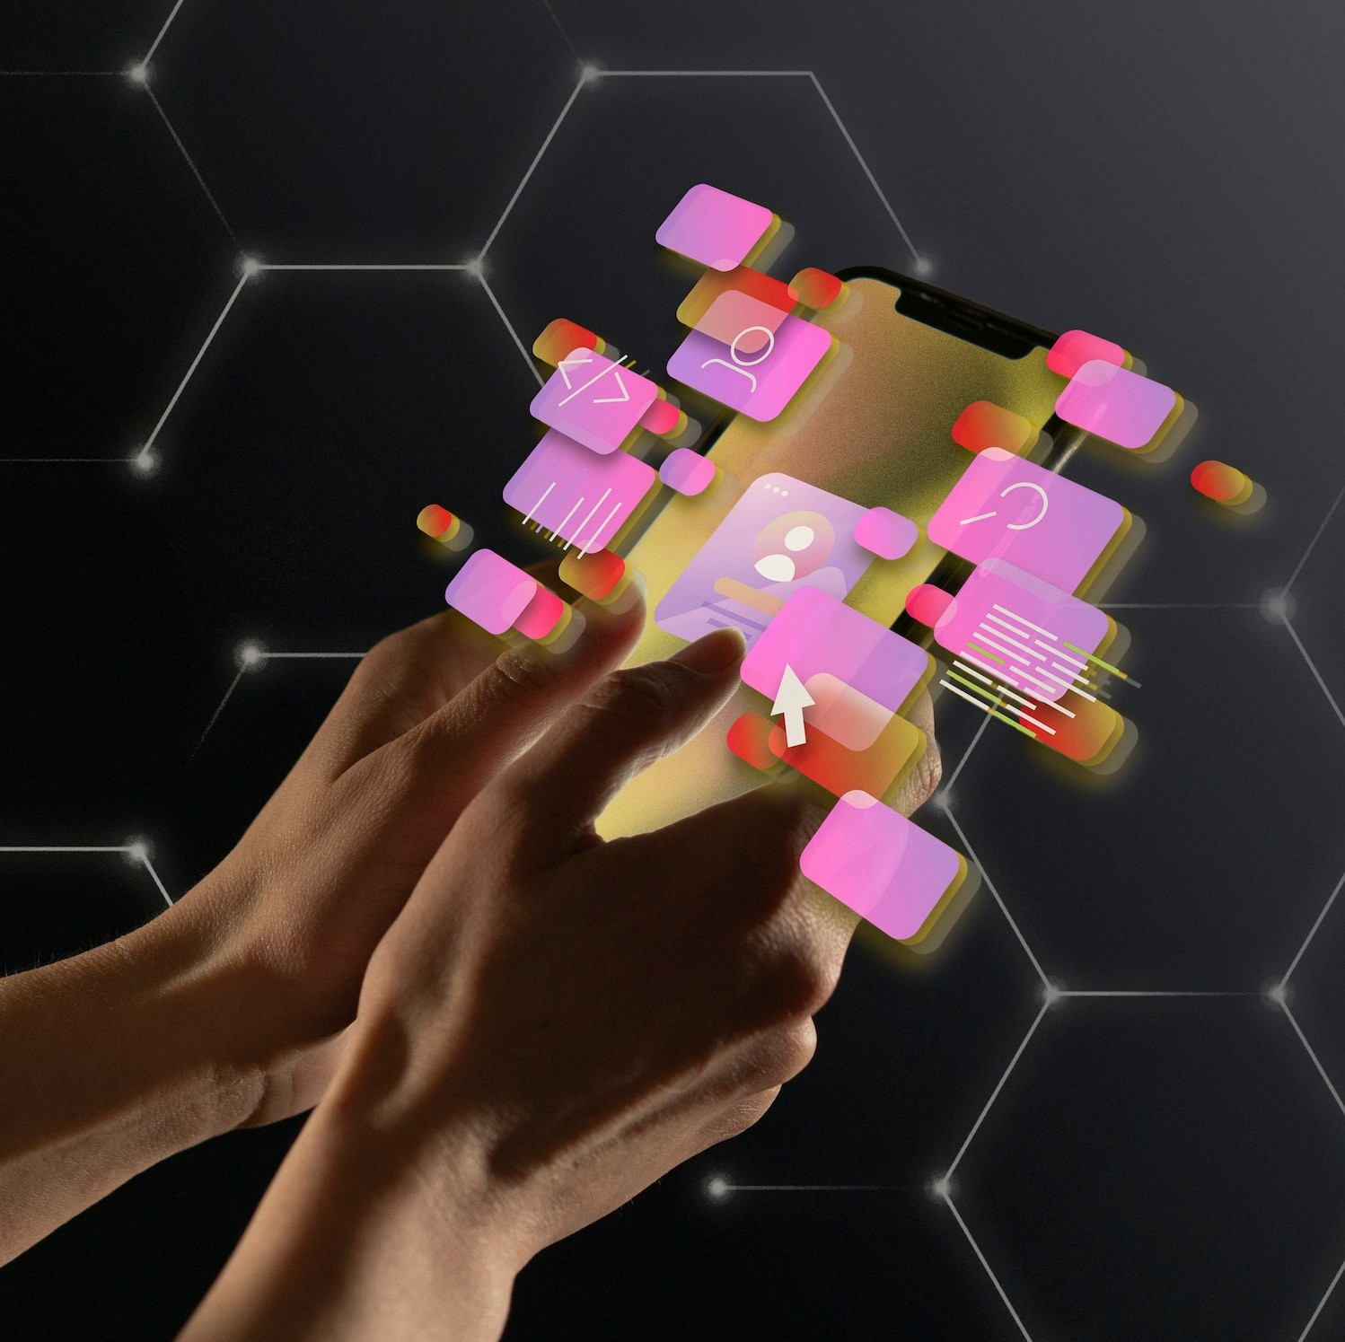
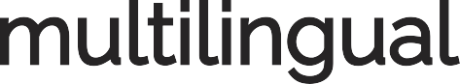
COMBINING OCR, NLP, AND TTS
The integration of , , and technologies creates a powerful system that can process text from files, images, and web pages. This combination enables seamless speech output, facilitating access to information for a wider audience.

Slide 8
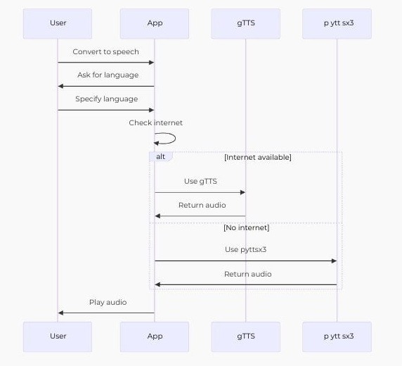
The Text Extraction and Speech Conversion App is a versatile Streamlit application that combines various technologies to provide a seamless experience for users. It handles multiple file formats, performs web scraping, and o ers translation and text-to-speech capabilities. The app's architecture ensures e cient performance through model caching and o ine capabilities.
With its intuitive interface and voice command feature, it caters to a wide range of use cases in text processing and language translation.

Slide 9
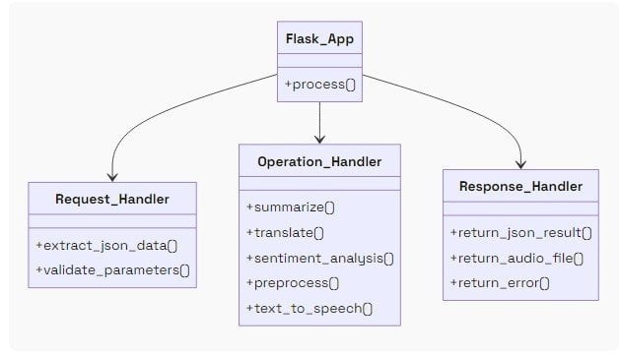
Flask Application Flow Diagram
This flow diagram illustrates the process flow of a Flask application'sendpoint. The endpoint handles various text processing operations including summarization, translation, sentiment analysis, text preprocessing, and text-to-speech conversion. The diagram shows how the application receives and processes requests, handles
di erent operations, and returns appropriate responses.

Slide 10
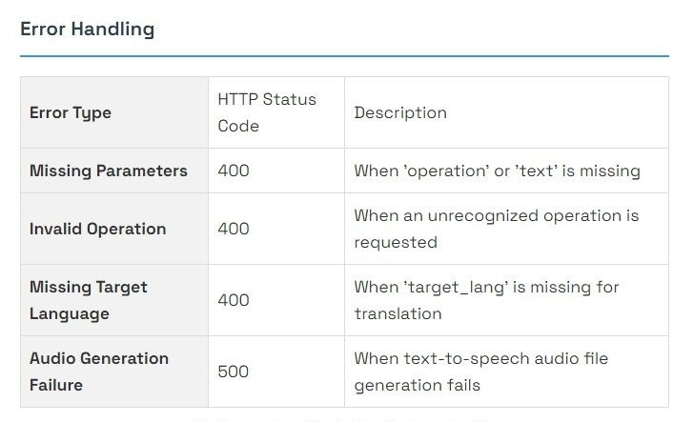
This Flask application provides a versatile API endpoint for various text processing operations. It demonstrates e ective request handling, parameter validation, operation-specific processing, and appropriate error handling. The flow diagram illustrates the logical progression from receiving a request to returning a response, highlighting the di erent paths based on the
requested operation and input validity. While the current implementation is straightforward, there's potential for
optimization and scaling to handle more complex scenarios and higher loads

Slide 11
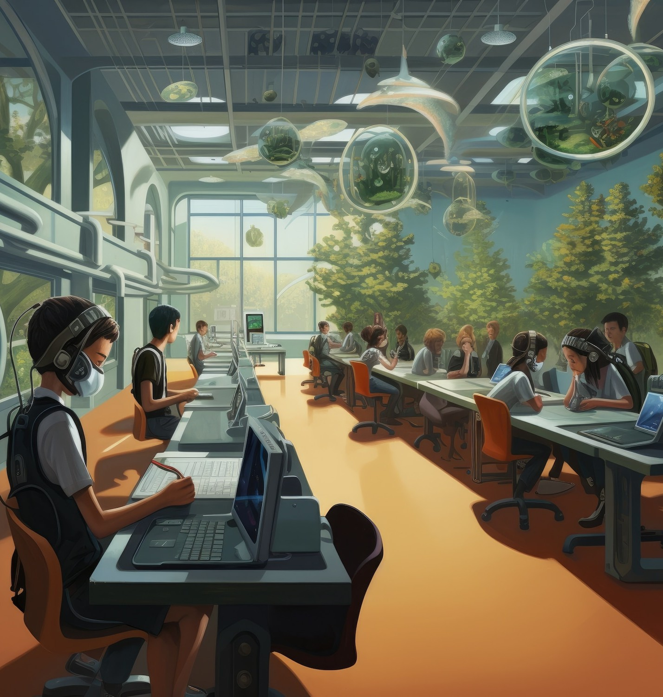

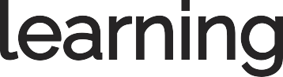

APPLICATIONS IN EDUCATION
Automated multilingual accessibility has significant implications in .
Students from diverse linguistic backgrounds can benefit from real-time text-to- speech conversion, enhancing their
and ensuring equal access to educational materials.

Slide 12


CHALLENGES IN IMPLEMENTATION
Despite the benefits, there are challenges in implementing automated multilingual accessibility. Issues such as in OCR, in NLP, and the quality of TTS voices can impact the eﬀectiveness of these technologies in real- world applications.

Slide 13
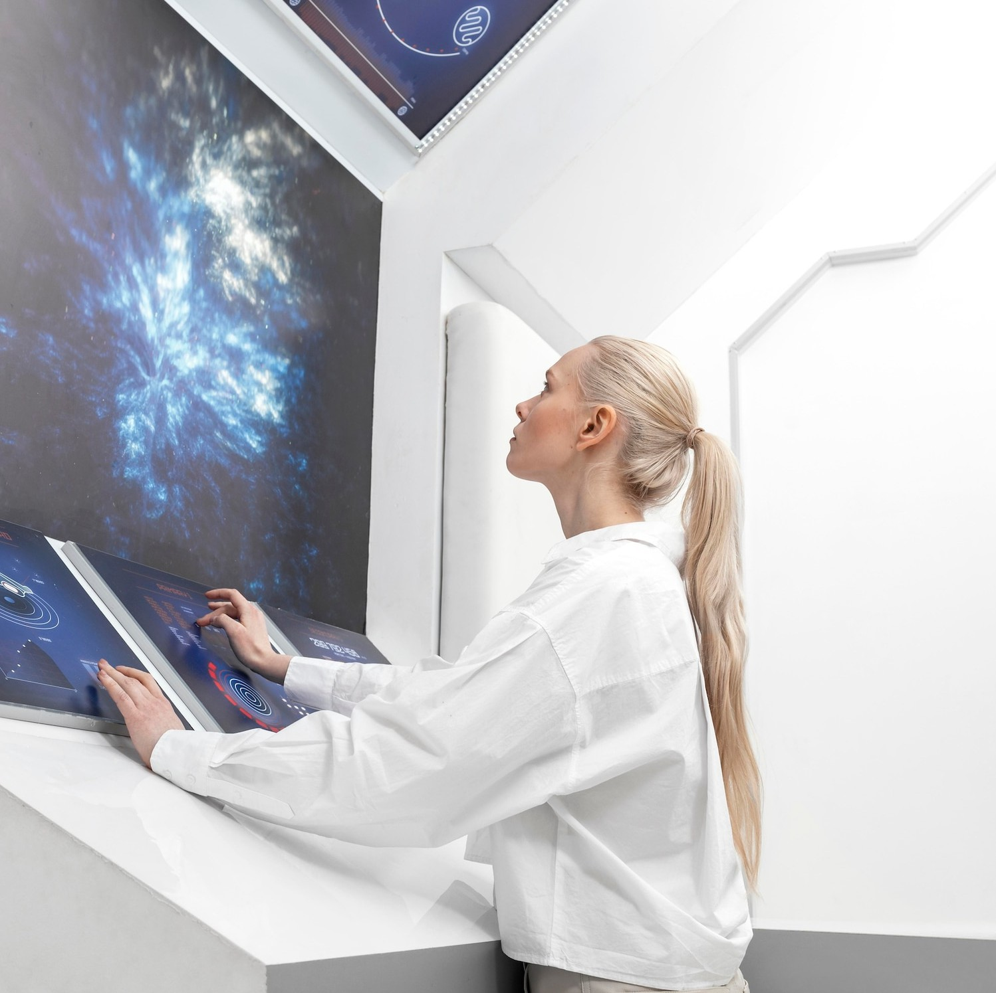
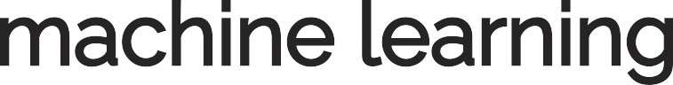
FUTURE TRENDS IN ACCESSIBILITY
The future of automated multilingual accessibility looks promising with advancements in
and . These
technologies will continue to improve the accuracy and effciency of OCR, NLP, and TTS, making information even more accessible for all.

Slide 14
CONCLUSION: A TRANSFORMATIVE APPROACH
Automated multilingual accessibility is transforming the way we access information. By leveraging , , and
, we can create a more inclusive world
where everyone has equal access to knowledge, regardless of their language or ability.

Slide 15
Thanks!

